Slide 1
Sheet Forming Processes

Slide 2
Basic Categories
Shearing
Bending
Drawing

Slide 3
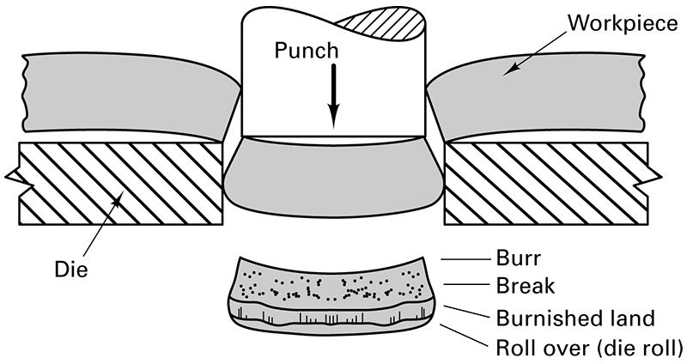
Standard Punching Operation

Slide 4
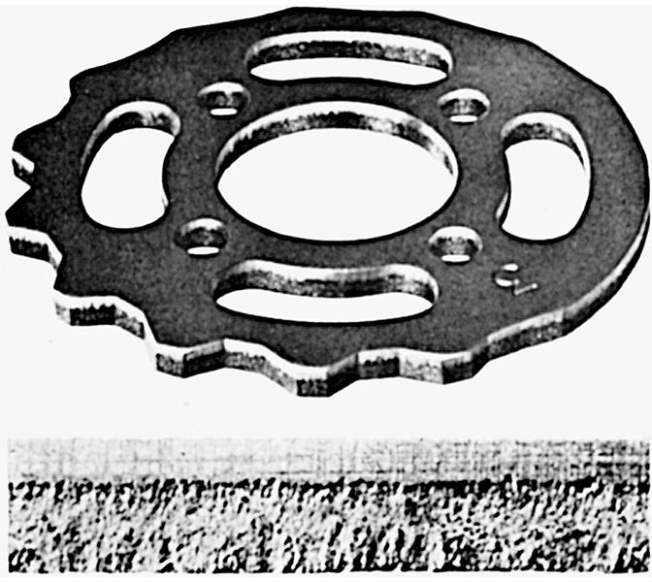
Conventionally Sheared Surface

Slide 5
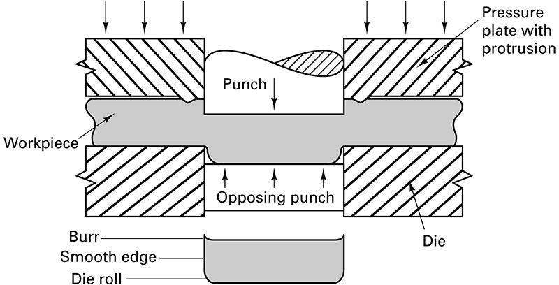
Fineblanking Process

Slide 6
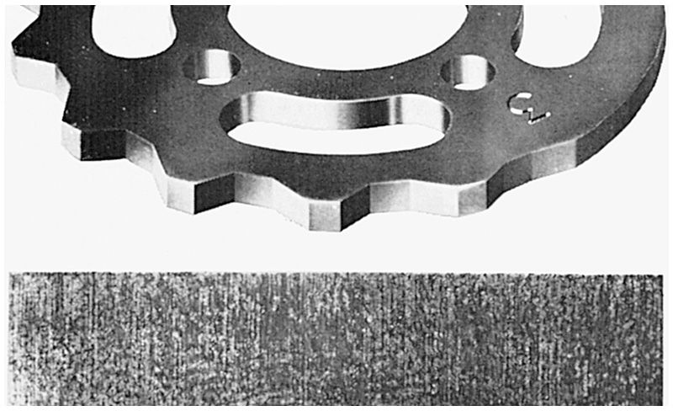
Fineblanked Part

Slide 7
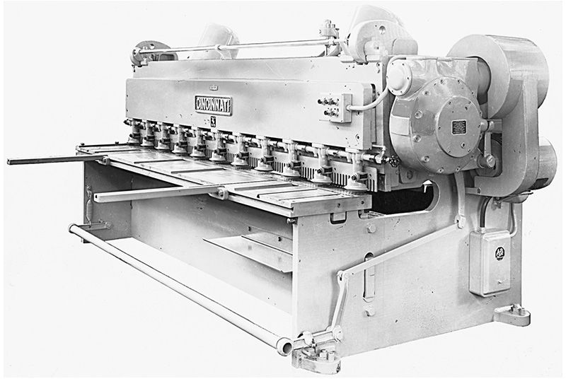
Power Shear

Slide 8
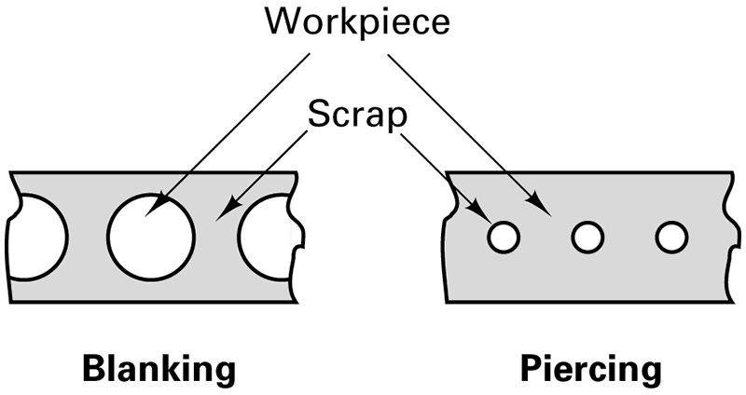
Piercing vs. Blanking

Slide 9
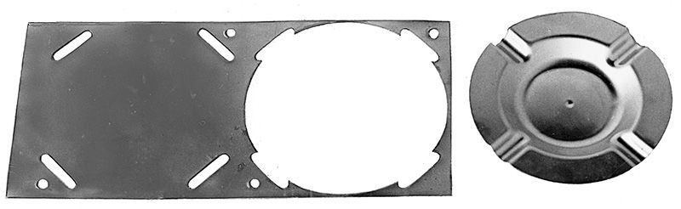
Piercing, Lancing and Blanking

Slide 10
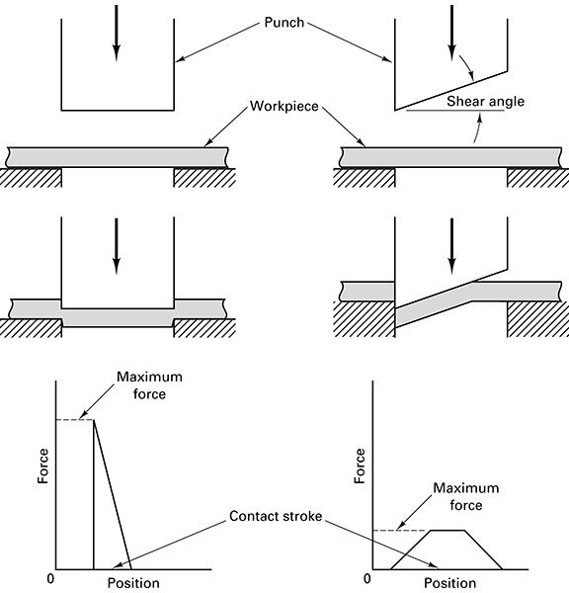
Blanking Punch Design

Slide 11
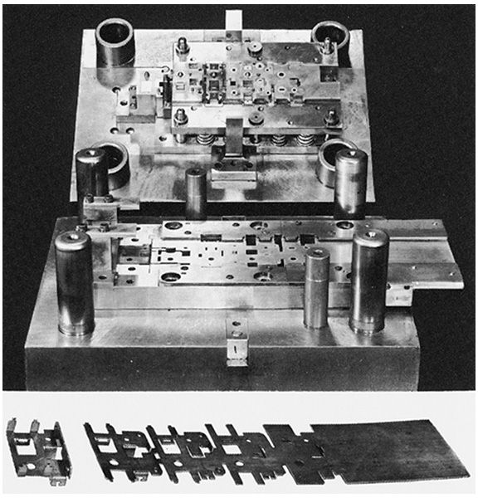
5-Station Progressive Piercing, Forming and Cut-off Punch and Die

Slide 12
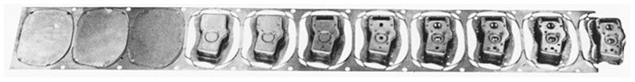
Stages of 11-Station Progressive Punch and Die

Slide 13
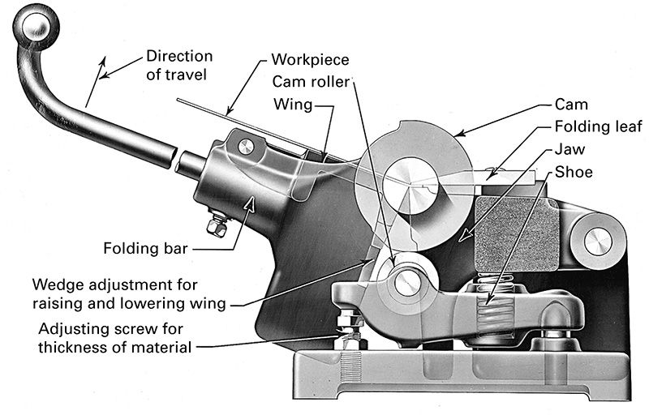
Bar Folder

Slide 14
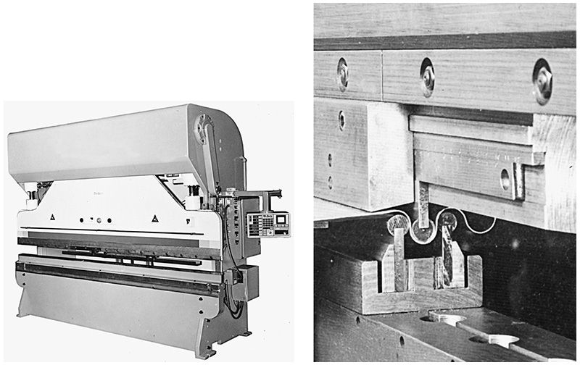
Press Brake

Slide 15
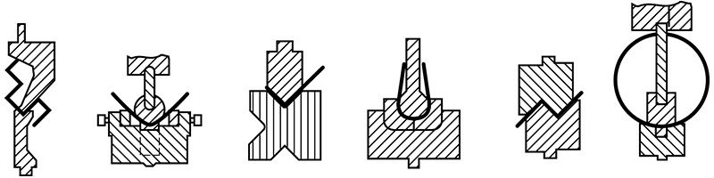
Bent Sheet Profiles

Slide 16
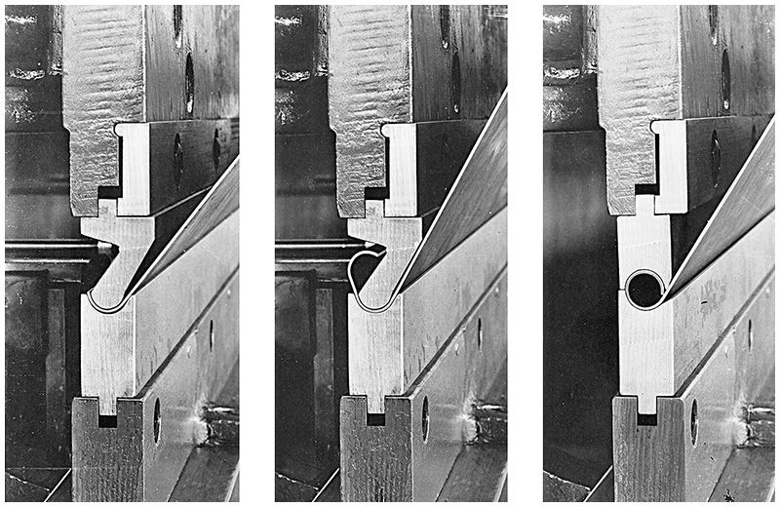
Dies Forming a Rolled Bead

Slide 17
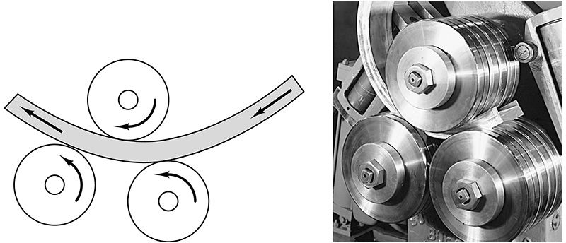
Roll Bending

Slide 18
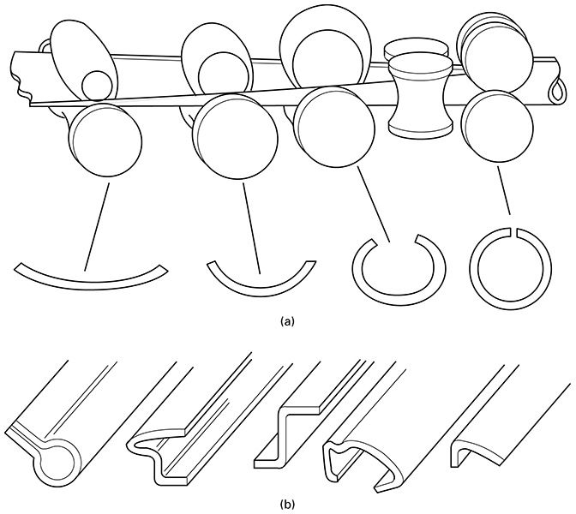
Bend Sheets into Shapes

Slide 19
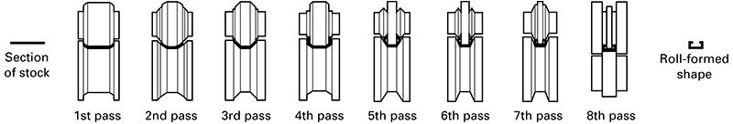
Forming a Box Channel

Slide 20
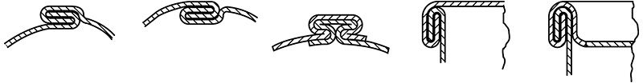
Sheet Metal Seaming

Slide 21
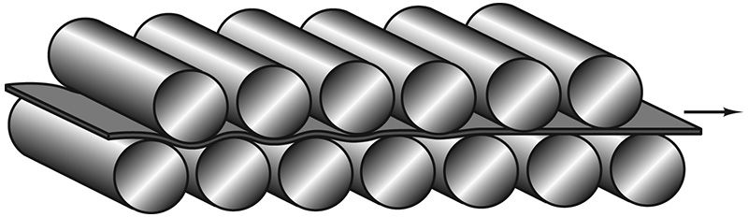
Straightening Sheets and Strips

Slide 22
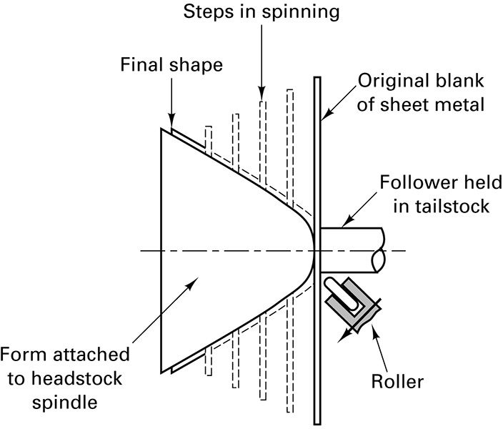
Forming Sheet by Spinning

Slide 23
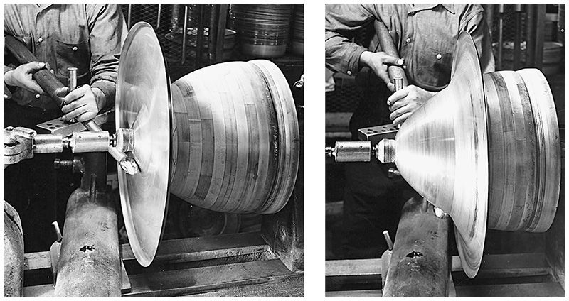
Forming a Reflector by Spinning

Slide 24
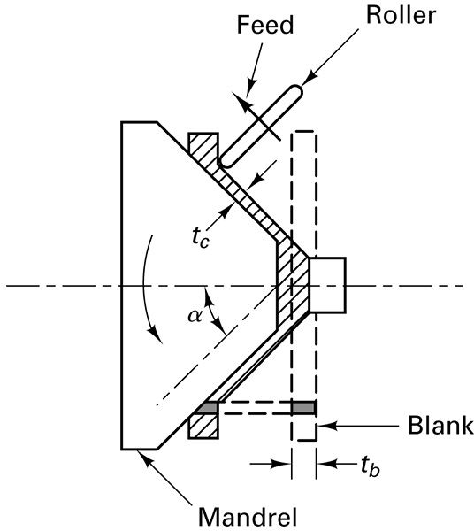
Shear Forming

Slide 25
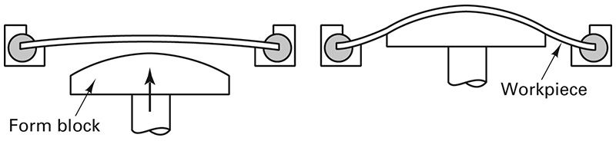
Stretch Forming

Slide 26
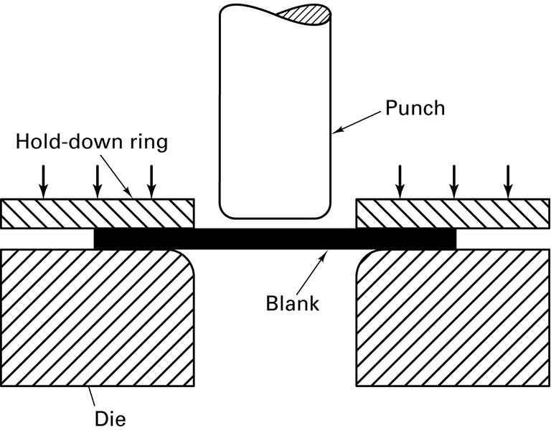
Deep Drawing

Slide 27
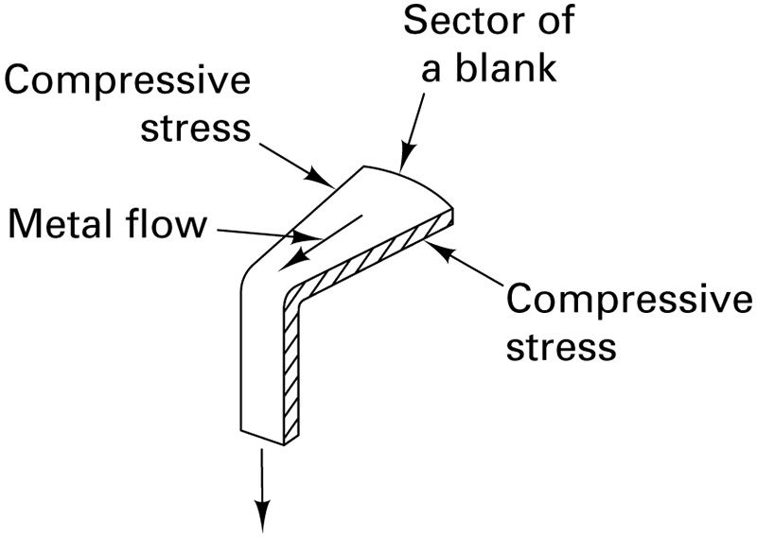
Metal Flow in Drawing

Slide 28
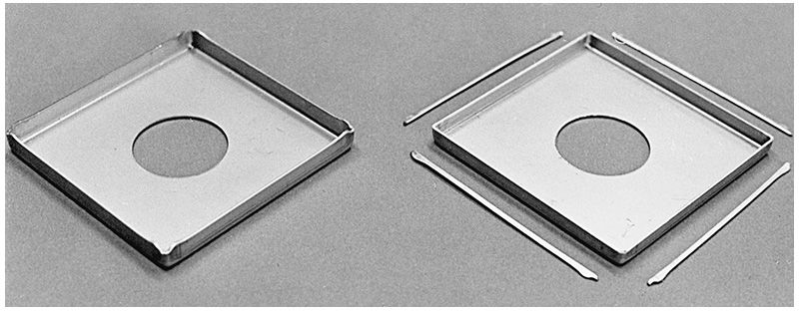
Piercing, Blanking, Drawing and Trimming

Slide 29
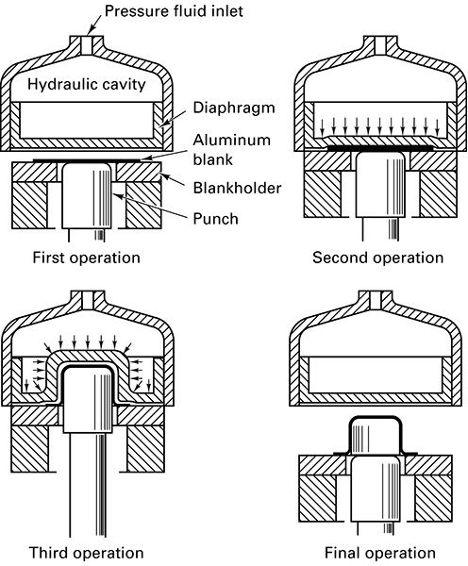
Hydroforming Sheets

Slide 30
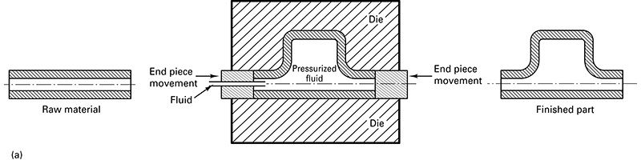
Hydroforming Tubes

Slide 31
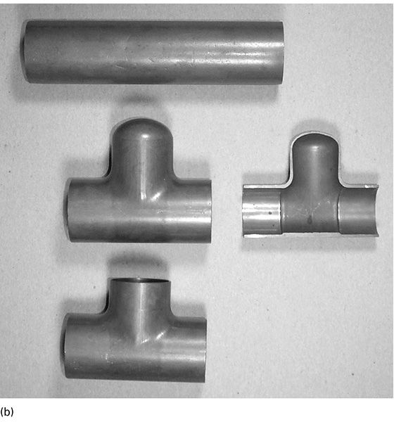
Cross-section of Formed Tube

Slide 32
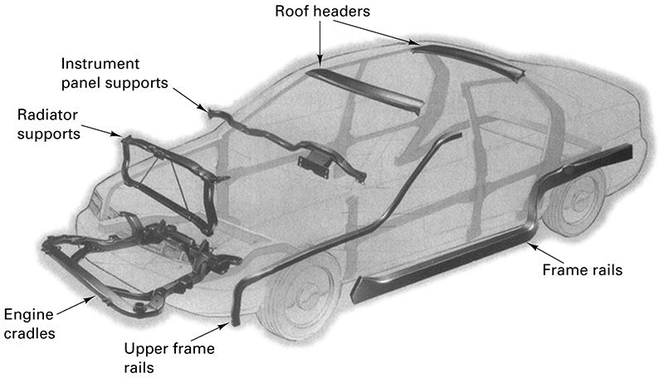
Formed Tubes in Auto Bodies

Slide 33
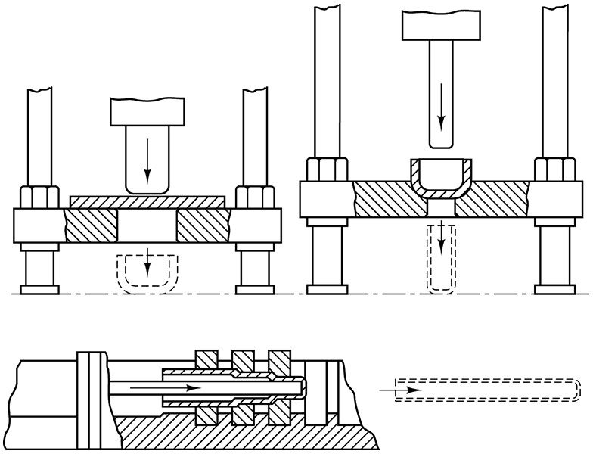
Hot Drawing

Slide 34
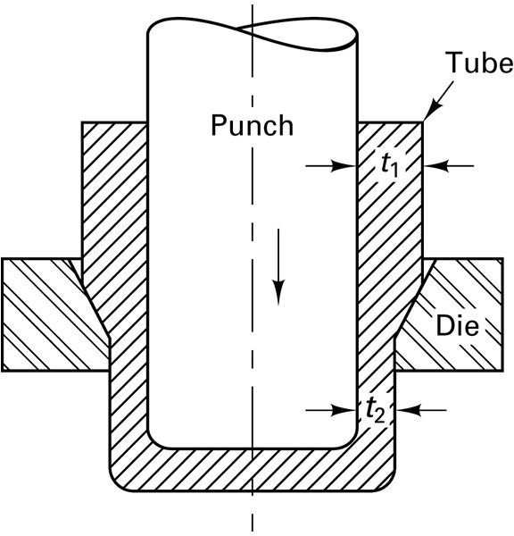
Ironing

Slide 35
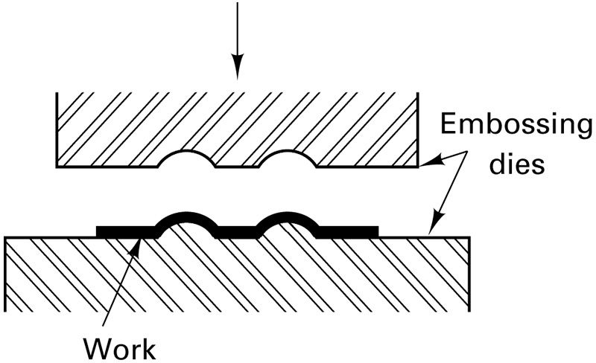
Embossing

